Slide 1

SCSP Summer Summit – 7th June 2024
Implementing changes to Working Together to Safeguard Children 2023

Slide 2
Why are we here?
Welcome from Sally Roberts – Chief Nursing Officer & Deputy CEO, Black Country ICB
Chair of SCSP Executive Group
“Everyone who works with children has a responsibility for keeping them safe. No single practitioner can have a full picture of a child’s needs or circumstances. Everyone who comes into contact has a role to play in identifying concerns, sharing concerns and taking prompt action.”
Working Together to
Safeguard Children 2023

Slide 3
What does Working Together cover?
Legislative requirements
In its entirety, to all education providers, and childcare settings
To all children up to the age of 18 years
Applies to all organisations and agencies who have functions relating to children
A framework for the local safeguarding partners to work together
!
This document must be complied with
unless exceptional circumstances arise

Slide 4
Purpose of the day
To set out the changes to Working Together 2023, which details what we all need to do to help, protect and promote the welfare of all children and young people under the age of 18 in England
To ensure there are clear understanding what these changes mean for us in Sandwell, both individually and collectively, including:
Our approach to work better together to Safeguarding and promote the welfare of all children in Sandwell
Our Practice Model Framework to work together
The arrangements to provide help, support and protection for children and their families through a new integrated front door
1
2

Slide 5
Key Speakers of the day
Lou Williams | Setting the scene with an overview of the legislative requirement, the national context and landscape for safeguarding children and young people, including key changes and developments that have taken place
Emma Taylor Kim Madill | The local response: the SCSP arrangements and reaffirm the commitments to a shared vision underpinned by a set of values and key principles for children in Sandwell Set out Sandwell's approach in response to national changes Reinforce what changes are required and the timeline for implementation.
Aman Basi Anne Holloway Claire Henley | The Partnership Practice Model – the joint approach for working with Parents and Carers to enable us to build strong, positive, trusting and co-operative relationships
Leah Arnold Kate Griffiths | New Integrated Front Door: Our approach to safeguarding is getting all children in Sandwell, the right help at the right time and from the right place.
Sally Giles Liz Murphy | Bringing it together and moving forward

Slide 6
Children in Sandwell are best safeguarded when key agencies work together effectively.
Sandwell Children’s Safeguarding Partnership (SCSP) is all of us and only together can we make this happen.

Slide 7
Achieving best long-term outcomes for children, young people & families
An overview of legislation & Statutory Guidance and the implications for our shared responsibility for providing help, support & protection
Lou Williams: DfE Improvement Adviser
June 2024

Slide 8
Background & Introduction
I am the DfE-appointed Improvement Adviser to Sandwell;
Improvement advisers are here to offer support & challenge to authorities, trusts and partnerships;
My previous roles include Director of Children’s Services before taking early retirement in 2022;
This presentation is intended to help us think about practice implications of:
  The recent suite of new statutory guidance, including Working Together 2023, on Information Sharing and links to core legislation;
  And our shared responsibility to maintain a culture that supports children, young people and their families, while identifying those experiencing harm.

Slide 9
Background & Introduction
We are all here because we want to support children and young people to do the best they can;
But working in this area is often complex and there can be a lot of fear about ‘getting things wrong’;
Over the years, there have been some apparently confusing and contradictory messages about how we should respond to children in need of help, support and protection, share information and so on;
Getting back to the underlying legislation and the associated statutory guidance can be helpful in thinking about the type of system of help, support and protection that we want as a partnership.

Slide 10
Key Legislation and Guidance
Children Act 1989
  Defines children in need and children in need of protection;
  Introduced the concept of working in partnership;
  Established the concept of the Welfare Checklist for consideration by the courts in proceedings;
  Set out the primary responsibilities of all agencies working with children and young people.
National Framework for Children’s Social Care;
Information Sharing: advice for practitioners… [May 2024].
Children Act 2004
  Established the concept of ‘Early Help’;
  Requires local authorities to coordinate activities by the partnership to improve outcomes for children and young people;
  No obligation for the LA to provide such services.
WT 2023 introduces some significant changes to 2018 guidance, including:
  Strengthening/clarifying early help responsibilities, and;
  Emphasising a more strengths-based approach to working with children and families;
  Introduces ‘Relevant Agencies’ – schools, key VCS organisations and similar;
  Lead and Designated Safeguarding Officers – roles responsibilities in 3 statutory agencies.

Slide 11
Early Help
Introduced by the Children Act 2004;
Requires Local Authorities to coordinate [i.e. not to provide] activities by the partnership that improve outcomes for children and young people;
Working Together 2018 and 2023 give examples of children who may benefit from early help;
What sort of issues might children be facing for the guidance to suggest early help interventions might be appropriate?

Slide 12
Early Help
WT 2018 and 2023 gives examples of children who may benefit from early help, including:
  Children with disabilities, special educational needs or who have mental health needs;
  Children showing signs of being drawn into criminal activities including radicalisation, county lines, serious youth violence and knife crime;
  Children at risk of trafficking, modern day slavery, criminal or sexual exploitation;
  Those who have family circumstances that pose challenges including drug & alcohol misuse, domestic abuse and parental mental health issues;
  Young people misusing drugs or alcohol themselves;
  Those who are persistently absent from education, including persistent absences for part of the school day;
  Has multiple suspensions and is at risk of or has been permanently excluded.
Why do we think these issues are considered potentially appropriate for an early help response?

Slide 13
How does the 1989 Children Act define a Child in Need and a Child in Need of Protection?
These are defined in the 1989 Children Act:
  S.17 of the Children Act 1989 defines a child in need
  S.47 of the Children Act 1989 defines a child in need of protection
How does the law define them?

Slide 14
The Law: Children Act 1989
A child shall be taken to be in need [s.17] if:
  [a] s/he is unlikely to achieve or maintain or to have the opportunity of achieving or maintaining a reasonable standard of health or development;
  [b] her/his health or development is likely to be significantly impaired, or further impaired, without the provision for her/him of such services, or
  [c] s/he is disabled.
Local authority duty to investigate [s.47]
  Where a local authority are informed that a child who lives or is found in their area:
  [a] i) Is the subject of an emergency protection order, or;
  ii) is in police protection
  [b] have reasonable cause to suspect that a child who lives, or is found, in their area is suffering, or is likely to suffer, significant harm,
  the authority shall make, or cause to be made, such enquiries as they consider necessary to enable them to decide whether they should take any action to safeguard or promote the child’s welfare.
The Act also says that the local authority should ascertain the wishes and feelings of the child about actions they are considering in respect of protection for the child, in accordance with their age and understanding and so far as is in accordance with the child’s welfare;

Slide 15
Sections 17 & 47 of the Children Act
Section 17B – A child shall be taken to be in need if:
  (b) her/his health or development is likely to be significantly impaired, or further impaired, without the provision for her/him of such services
If significant impairment is Child in Need, how can this be differentiated from child protection - s.47?
The word ‘Risk’ does not appear anywhere in the Children Act….

Slide 16
Sections 17 & 47 of the Children Act
Legislation is drafted very carefully, and wording used deliberately:
Definition of ‘to impair’ is:
  to make worse, to diminish functioning or ability.
Definition of ‘to harm’ is:
  to deliberately inflict injury, suffering, distress or damage.
This distinction is particularly helpful when thinking about the appropriate initial response where a child may be suffering significant impairment or significant harm, but is likely to be less so where we have been engaged supporting families over the longer term;
Strengths-based practice means intervening at the lowest appropriate level: if additional concerns are identified, s.47 enquiries can always be instigated at a later date;
What are parental rights at s.17 and s.47? Do they differ?

Slide 17
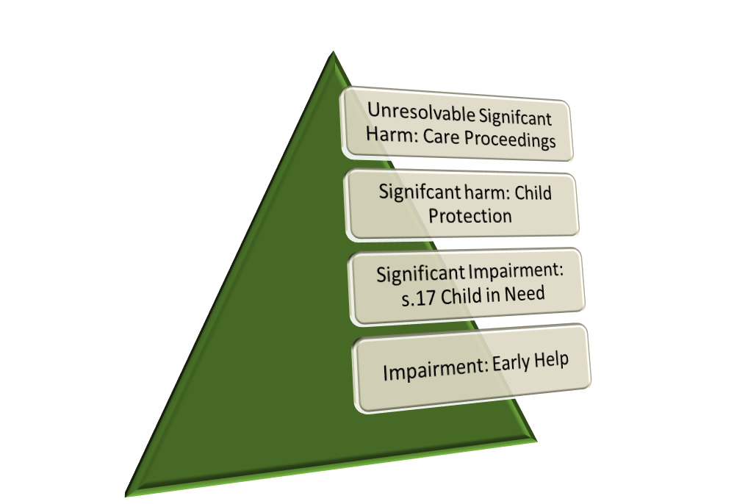
Children Act 1989: Impairment, significant impairment, harm and strengths based practice
Child protection, s.47 threshold is where a child is suffering or is likely to suffer significant harm;
Engagement at all levels below care proceedings requires consent and/or family agreement;
Parents can decline services where their child is suffering significant impairment;
Declining services does not mean that the threshold for s.47 is met unless the child is likely to suffer or is suffering significant harm;
Making of court orders require several further tests including that taking action will be better for the child. This means that refusal to engage at s.47 does not automatically result in threshold for a care or supervision order being met;
S.14 of the Act requires local authorities to give due regard to a child’s wishes when determining what services to provide under section 17 and before making decisions about action to be taken to protect individual children under section 47;
Care proceedings are the only area in which local authorities have more power than others to intervene in family life.

Slide 18
Practice Implications
We all obviously want to ensure that children and young people do as well as they can;
This requires building trust and offering support as appropriate;
It highlights the importance of strengths-based approaches and working alongside parents, children and young people;
Keeping Children Safe in Education 2023 says that schools and others must refer to WT 2023, which states:
‘All practitioners should work in partnership with parents and carers as far as possible. Parents and carers need to understand what is happening and need to be supported to say what they think. This is particularly important when there is reasonable cause to suspect that a child is suffering or is likely to suffer significant harm. Working collaboratively will mean parents have the best chance of making changes and practitioners can make fair and accurate decisions about how to support children and keep them safe….’
  Use strengths-based approaches and explore with parents how using their strengths could support them to effect positive change;
  Enabling parents to participate in decision-making through a culture of ‘no surprises’, giving parents adequate preparation at every stage, signposting to support and helping parents to understand what the issues are, what decisions might be made and what needs to change, why and how, timescales and possible outcomes.

Slide 19
A note on the legal basis for information sharing
Latest guidance [May 2024] on information sharing clarifies the basis for sharing information about a child where the concern is about safeguarding is usually based on ‘legitimate interests’ rather than consent;
If the issue is about seeking support for a family, then consent is more likely to be required and will form the legal basis;
Either way, the most recent guidance is clear that:
  ‘Trusted relationships are at the heart of working with children & families…’
  ‘If you have concerns about a child's safety or welfare […] being upfront, transparent and honest about your concerns can give children the confidence to open up. It may also increase a parent’s or carer’s willingness to engage with services that provide family support…’
So statutory guidance remains clear that we need to speak to families before referring, except in tightly defined and specific circumstances.

Slide 20
Strengths based practice and early/family help
‘Early help’ is not a very helpful term;
Some assume that it refers to a specialist team or service;
Anyone working with children, young people and families is undertaking early help activities;
Where there is a need for more focused activity, terms like ‘Early Help Assessments’ often start being used;
It may be more helpful to think more in terms of early help plans, which some areas have found helps to build positive engagement between practitioners, services and families;
Developing confidence to support children and families at the right level in the system.

Slide 21
The problem of being ‘safe’
Very high numbers of contacts into children’s services mean that there can be less time available to consider the needs of children in depth;
Families find child protection enquiries and social work assessments very stressful and they are resource intensive;
Where high proportions of these end up as no further action or a step down to early help, families are often less likely to engage;
Engagement with support is voluntary where a child is experiencing significant impairment;
When a person acknowledges they may need help and support, they are much more likely to accept if it is brokered quickly and by a person they already know and trust…

Slide 22
Creating the conditions for best long term outcomes
Even where you are worried about significant impairment or harm, in almost all circumstances, the best initial position is to have a strengths-based discussion with parents/child/young person as appropriate;
Many families are reluctant to engage, which means that this can take patience and tenacity;
This means remaining curious about children and their lived experience & alert to the possibility of significant harm, while building trust, confidence and resilience for families & children;
The responsibility of the system as a whole is to crate a culture that enables the making of defendable rather than defensive decisions:
  Understanding legal basis to intervention and promoting best long-term outcomes;
  Training and support for practitioners in holding strength-based conversations;
  Ensuring that those engaged in front-line practice and their managers are able to access consultation and support with decision making;
  Moving away from a culture of referring on to one where there is greater confidence to engage children and families in a context of what is most likely to promote long term outcomes.

Slide 23
Concluding Remarks
The legislation is clear; it is our collective responsibility to safeguard children and ensure that children remain within their families whenever possible;
A very small minority of parents deliberately cause harm to their children;
Our collective responsibility is to work together to ensure that we offer children, young people and their families effective support:
  Respecting their right in most cases to decline, but continuing strengths-based discussions when they do, and;
  Taking clear action where we have reasonable cause to believe that a child may be suffering or is suffering significant harm.

Slide 24
Working Together 2023
What it means for Sandwell
Emma Taylor – Chief Executive, Sandwell Children’s Trust
Kim Madill - Chief Superintendent, West Midlands Police

Slide 25
Sandwell Safeguarding Partnership Framework
MULTI-AGENCY SAFEGUARDING ARRANGEMENTS
INDEPENDENT SCRUTINY
Chief Executive
Local Authority
Chief Constable
Police
Chief Executive
Integrated Care Board
LEAD Safeguarding
Partners
Executive Group
LA
DCS
Children’s Trust
CEO
Police
Chief Supdt
ICB
Deputy CEO
DELEGATED Safeguarding Partners
Operational Group
Relevant Partners
Delivery of Priorities
Business Manager & Business support function
Sub-groups as agreed by partners

Slide 26
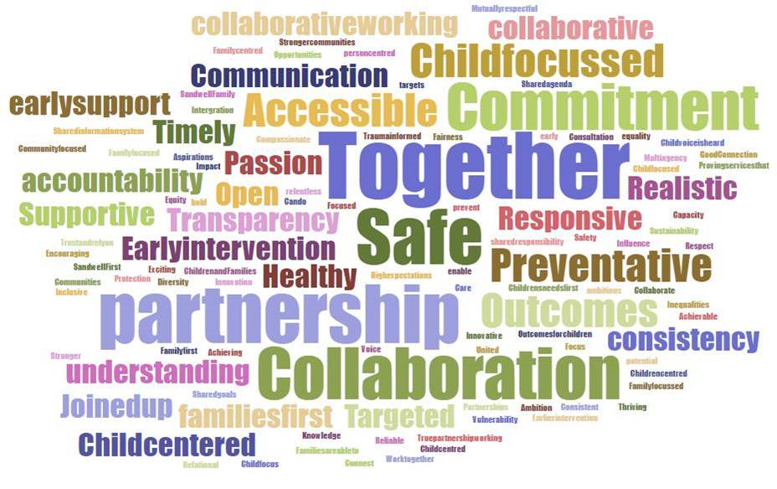


Sandwell Safeguarding Children Partnership Vision
All children to be safe at home and in their communities, where they are loved, cared for and have the stability to grow healthily and achieve their ambitions

Slide 27

Our Values and Principles
Values
Principles
Children at the heart
of what we do
Make a difference
Mutual trust, inclusivity,
respectful challenge and curiosity
Together we will make Sandwell safer for children
Effective decision making and
joint accountability
Always listen, learn and improve
Respect for each other, recognise & respond to difference
Listening and learning
Shared approach to
working with families
Positive about the future and aspire for children to be solution focused, committed and innovative
Strong Leadership

Slide 28
Emphasis within Working Together 2023
Shared responsibility
clarification of roles
Family Help
Stronger emphasis and expectations
Diversity and personalised
Working with families & appreciating differences
Help, Support & Protection
Same goals- in & outside the home
Wider range of safeguarding partners
schools, colleges, education providers, voluntary community
Shared learning
Serious Child Safeguarding Incidents (plus Child Death Reviews)

Slide 29
A Shared Responsibility
Successful outcomes for children depend on strong multi-agency partnership across the whole system
Multi-agency expectations
Everyone involved in safeguarding & child protection
Identification and response –
Help at earliest point to prevent needs rising
Collaboration, co-ordination & cooperation
Effective resources between us
Continuous learning and challenge
With and from each other

Slide 30
Providing Help, Support and Protection
Early help
Safeguarding & promoting the welfare of children
Child protection
Family help- early identification and response to need- whole family approach
Keeping families together- increased use of family networks and guidance on family group conferences
Strengthened role of education and childcare settings
Lead Practitioner role- broader range for Children in Need (S17)
Disabled children- specific needs, strengths based, improve link between social care & SEND system
Harm outside the home- multi-agency response- groups or individuals
National multi-agency standards- actions & behaviours to improve practice and outcomes- all forms of abuse, in and outside the home
Child protection- clear distinction- Social Worker led
Extra-familial harm in social care assessments (resources to support response to online harm
Accountability - scrutiny and challenge - every level

Slide 31
Social Care National Framework:
Supporting Children and Families
Enabler 1
Enabler 2
Enabler 3
Multi-Agency Working
Leaders drive conditions for effective practice
Workforce is equipped and effective
Enablers to ensure systems are effective
Outcome 1
Outcome 2
Outcome 3
Outcome 4
Children, young people and families stay together and get the help they need
Children and young people are supported by family networks
Children and young people are safe in and outside their homes
Children in care and care leavers have stable, loving homes
Outcomes that should be achieved so children can thrive
Voice of children, young people and families- central

Slide 32
Sharing Information
“No single practitioner can have a full picture of a
child’s needs and circumstances so effective
sharing of information between practitioners,
local organisations and agencies is essential for
early identification of need, assessment, and
service provision to keep children safe.”

Slide 33
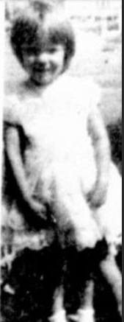
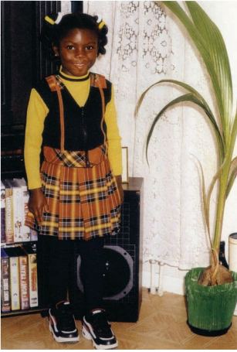
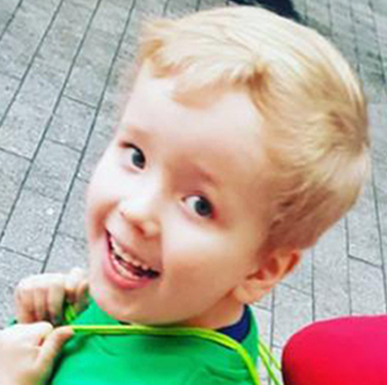
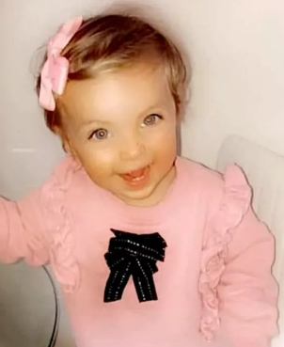
Working in Partnership
Information sharing
Full picture
Challenge

Slide 34
What it means in Sandwell
Embed arrangements- Executive & Operational Groups, Workstreams and Summits
Consider all strategies & guidance- plan for how we will meet these expectations and support families
Publish new safeguarding arrangements (December 24)
System and culture change…..

Slide 35
Progress already underway……
Integrated Front door
Help Vs Harm- link to wider family help system
Shared responsibility- avenues to advice and guidance
Consent and information sharing
Practice
Shared model
Strengths based, trauma informed, relational
Consistency- how we speak, act and engage

Slide 36
STaR Shared Partnership Practice Model
Aman Basi – Sandwell Children’s Trust
Anne Holloway – Black Country ICB
Claire Henley – Sandwell Family Hubs, Barnardos

Slide 37
Objectives
To understand why we need a shared Practice Model
To understand what we are already doing well that fits with the Practice Model
To think about what challenges we may encounter and solutions for how we can overcome these
To think about the benefits of a shared practice model
1
2
3
4

Slide 38


Why do we need a shared Practice Model?
Enables a culture change shift in the way in which we practice with children and families as well as with each other
Provides us with a clear set of expectations from each other
Enables a consistent approach with children and families
Creates a common language for children and families as well as professionals

Slide 39
What the Practice Model means for the partnership, no matter what your role is
How we respond to families when they need our help, how we build on their strengths and understand their story and history
How we speak with families and with each other
How we engage and form relationships
How we determine whether a parent is able and motivate to change
How we see and manage risk and vulnerability
How we support children and families together
How we commission services across the partnership
How we know we are making an impact – Quality Assurance and performance

Slide 40

The Practice Model
RELATIONSHIP BASED PRACTICE
PARTNERSHIP & PREVENTION AT EVERY LEVEL
REFLECTIVE SUPERVISION
WRAPAROUND SUPPORT & EVIDENCE BASED INTERVENTION
TRAUMA INFORMED PRACTICE
PARTICIPATION & CO-PRODUCTION
MOTIVATIONAL INTERVIEWING
STRENGTHS
BASED PRACTICE
DIRECT WORK
(INC. LIFE & MEMORY WORK)

Slide 41
Component parts of the STaR Practice Model
STaR model
STRENGTHS
BASED PRACTICE
TRAUMA INFORMED PRACTICE
RELATIONSHIP BASED PRACTICE
Our practice
model is
Strengths based, Trauma informed
and
Relationship based approaches
Understanding individuals & families’ strengths, what works well, and celebrating successes. Families are experts in their own lives – finding solutions together
Understanding and respond to past and present trauma and how this affects us in the way we think, we behave and live our lives
Developing and nurturing trustful, respectful relationships by preparing, investing the time and be curious (using a range of tools)

Slide 42
Component parts of the STaR Practice Model
PARTNERSHIP & PREVENTION AT
EVERY LEVEL
WRAPAROUND SUPPORT & EVIDENCE BASED INTERVENTION
MOTIVATIONAL INTERVIEWING
DIRECT WORK
(INC. LIFE &
MEMORY WORK)
PARTICIPATION &
CO-PRODUCTION
REFLECTIVE SUPERVISION
To have a shared responsibility and approach in managing needs and risks and evaluating if families are able and motivated to change
To work effectively with children and families so children can remain safely at home, utilising all of our skills to intervene and measure progress.
To work with families in a way that motivates and empowers them to make long term, positive changes to their lives
To build relationships with children and families to enable them to better understand their views and lived experience.
To ensure we have children and families participation with us at every stage of our involvement with them, so we work together to identify solutions and provide better options.
To understand how trauma has affected our children
and families and how this affects our thoughts, feelings, and values when we are working with them.

Slide 43

Table Focused Discussion
What language would you use to demonstrate you are a STaR Practitioner?
What behaviours would you display to demonstrate you are a STaR Practitioner?
1
2

Slide 44
Individual Reflections
What do you need to keep doing ?
What changes might you need to make?
Consider our discussions and aspirations to become a STaR Partnership with shared language, behaviours and ways of engaging and working with children and families as well as other professionals…
?
?

Slide 45
Help vs Harm
Introducing our Integrated Front Door
Leah Arnold and Kate Griffiths

Slide 46
What does an effective Integrated Front Door mean to you?

Slide 47
Help vs Harm: Integrated Front Door
Points of access to help, support and protection for children
Getting the right help at the right time
Ingredients of an effective IFD
Information, advice & guidance
Gathering & analysing information
Each component of the IFD is reliant on other areas of the system (partnership) working well together
Sharing information well
Evaluating family strengths and risks
Universal Support
Using Early Help appropriately
Early Help System (Single and Multi-Agency)
Culture of placing the welfare
of children at the centre
MASH
Valuing professional disciplines & expertise
Notes:
Custom and practice- MASH

Slide 48
Help vs Harm: Whole system
Family Help
Harm
Universal Help
Single Agency Help
Multi Agency Help
Specialist help
Help required
Service for everyone
One need, single agency response
Two or more needs are identified, with two or more agencies need to provide help
Significant and immediate concern for a child
Open access - families access support as required.
Services respond to presenting needs of families.
Team around the family (TAF).
Integrated Front Door and MASH
Response to
the family
Notes:
Front door is not the system itself or first point- points in system prior to front door being needed

Slide 49
Help vs Harm- Shared responsibility
Line Manager Report / Supervision
Designated Safeguarding Leads
MASH
Community Network Meetings/ Family Hubs
Strengthening Families Service
Integrated Front Door
Notes:
Shared responsibility to ensure effective conditions for practice/ support for frontline practitioners- also got a proportionate response

Slide 50
Help vs Harm: Collaboration, Coordination, Cooperation
The Designated Safeguarding Lead for your organisation
Sandwell Family Life portal (Service Directory)/SCVO Targeted portal
The Family Hub including the website
The local Strengthening Families Service Team
Community Network meetings (termly)
Monthly Lead Professional ‘lunch and learn’ through SCSP
The Early Help Desk in MASH
SCSP Dispute Resolution Process

Slide 51


Our Approach to Safeguarding
Getting all children in Sandwell, the right help at the right time and from the right place.
Community Coordinator
GP
Health Visitor
Alternative Provision
Benefits
Library
Mental Health
Speech & Language
Housing
Maternity Services
Fire & Rescue
Prison
Police
Special Education Needs
Youth Offending & Youth Service
School
School Nurse
Family Support
Social Care
Family Hubs
CAFCASS
Community Nursing
A&E
Drug & Alcohol Misuse
Jobcentre Plus
Probation
Early Years Setting
Post 16 Education
Family & Friends
Place & Environment
Community
Local Business
Online Support
Voluntary Faith & Community Services
Notes:
hide

Slide 52
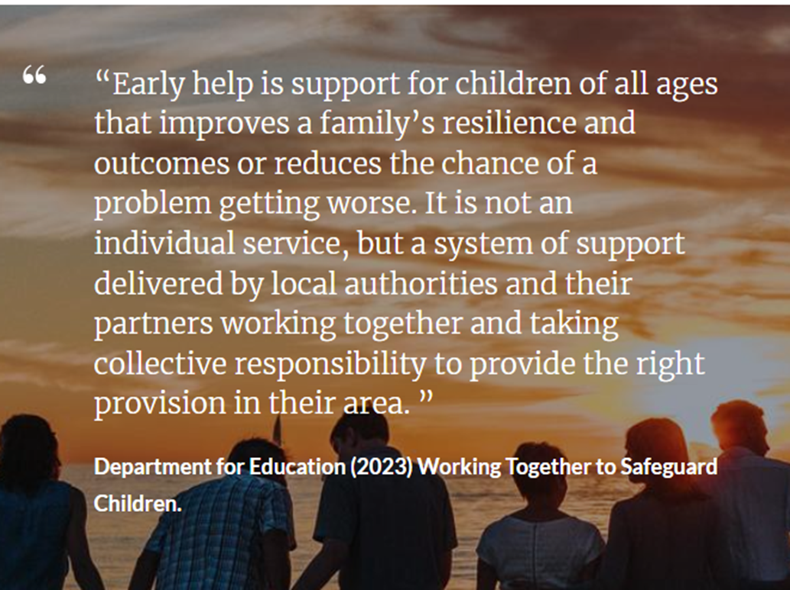
Working Together 2023
Notes:
Reinforcing need to get advice, guidance through the pyramid – use all these avenues to help families- if not successful- contact with the integrated front door

Slide 53
Integrated Front Door
Protecting Children from Harm
(MASH)
Phased implementation 2024-2025

Slide 54
How we have approached the review
Set up the review
Agree objectives, scope & resources
Establish working group
Identify stakeholders
Methodology
Formation of Core Working Group (CWG) inclusive of SCSP Independent Scrutineer, reps from SCT, SMBC, WM Police, Health & Education
Consultation with BCWA, Probation & Housing
Gather & analyse information
CWG analysed information from:
Performance data & demand pattern
Individual agency self-evaluation & feedback
Exploration of best practice with two LA’s
Appraisal of internal staffing, vacancies, effectiveness of job roles, responsibilities and JD’s
Expert view (Professor Thorpe)
Engage stakeholders
Each agency representative assessed and evaluated information gathered from staff within the Front Door considering:
  Maintenance of good practice, Barriers and how to overcome them, Views on how to further improve the service
  Discussions & reflections to inform future model
Implement & Review
Identify recommended option
Develop timeline and implementation plan
Implement & monitor
Report outcomes and share learning
Continuous improvement

Slide 55
Findings
Too many initial contacts with an outcome of information & advice
Inconsistent feedback between MASH & referrer (not WTSC compliant)
85% of initial contacts do not meet threshold for further assessment
Current processes do not maximise benefits of MASH principles and use of partners (impact on recommendation for strategy discussion or statutory assessment)
Increase in number of contacts via telephone
All requests for MASH via contact centre recorded as an initial contact within EHM:
Limited ability to analyse
Increased demand on staff to read, review and sign off within EHM, Contact centre
Limited evidence of learning culture driving improvements

Slide 56
Key Changes
Supporting the Changes
Conversational model
Information sharing, parental awareness & consent
Triage
RAG rating
Partner agency checks & analysis
Thematic dips & practice reviews
Feedback & support to partners
STAR Practice Model (Motivational interviewing training)
Review and updating: Threshold guidance (Protocol for assessment & Support) & online information – WTSC 2023, DfE Information Sharing April 2023, KCSE 2023
Training & support across SCSP (Development Day, Partnership Summit, Practice Model, thematic audits & dips)

Slide 57
Final Reflections and Moving Forward
Sally Giles – Director of Children and Education Services, SMBC

Slide 58

SCSP Autumn Summit
October 2024
Publication of the MASA – December 24
Phased approach to implement the Partnership Practice Model
Fully functioning Integrated Front Door: March 25
Implementing the Social Care National Framework: setting the direction for Practice

Slide 59



